Slide 1




AWS AI: Smarter Cloud-Native with GenAI
KSUG.AI – 20-Minute Live Demo Session
by Yongkang He
Founder @KSUG.AI @KubeSmart.AI
Creator @awstronaut @kubestrong
https://ksug.ai

Slide 2




AWS AI & ML Offerings
Foundation Models
Amazon Bedrock (Claude, Titan, Llama 3, Mistral)
ML Platform
Amazon SageMaker (End-to-End ML)
AI Services
Rekognition, Comprehend, Polly, Transcribe
https://ksug.ai

Slide 3
Today's Live Demo
Build
Tools
PDF Summarizer with Claude via Amazon Bedrock
LangChain
Claude v2 on Bedrock
Jupyter Notebook
https://ksug.ai

Slide 4
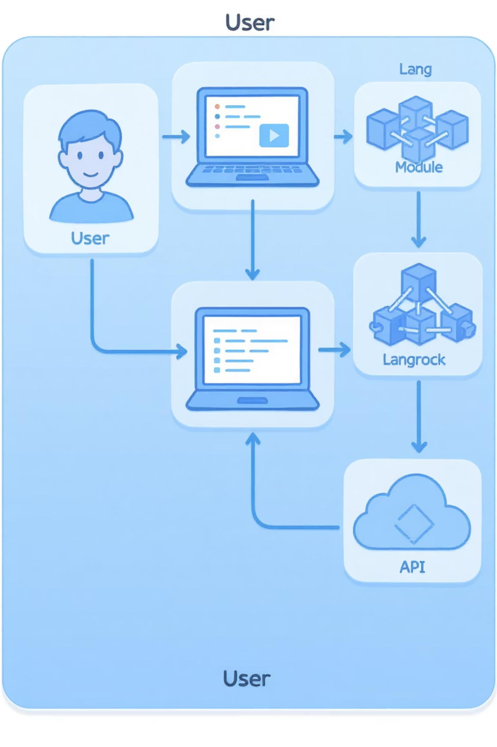




Architecture Diagram
User
Upload PDF
LangChain
Process document
Bedrock (Claude)
Generate summary
Output
Display results
https://ksug.ai

Slide 5

How It Works (Code Flow)
Extract Text
Load PDF → Extract with PyPDF2
Configure Claude
Load Claude via LangChain + Bedrock client
Process Content
Run prompt template → Generate summary
Present Results
Display in Jupyter Notebook
https://ksug.ai

Slide 6
Resources & Community
Code & Docs
Join KSUG.AI
GitHub:
https://github.com/ksug-ai/amazon-bedrock-summarizer
Learn FASTER ⚡
Certify SMARTER 💰
Docs: Bedrock, LangChain, Boto3
Grow STRONGER 💪
https://ksug.ai

